Slide 1

“Falcone Airlines Customer Satisfaction”
By Khaled Majzoub

Slide 2
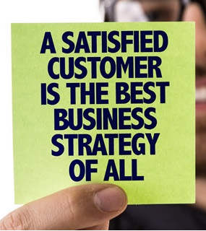
The Problem
Dilemma
Wants to increase customer overall satisfaction
They want to spend
What Makes Satisfaction?
LEAST Mon$yTim$$ffort
They want a RECIPE that makes their customers satisfied
2x data sets
Most Important Variables
Ex | Flight Data (9) | Survey Data (16)
1 | Age | Seat Comfort
2 | Delays in Mins | Overall Satisfaction
3 | Distance | Food and Drink
They surveyed 91K passenger
Is It Feasible?
LIKERT scale (from “excellent” to “extremely poor”)
4 questions have NUMERIC answers like age & delays
Total data variables 25 and 1 common variable (ID)
Target Q: Are you Satisfied or Not?
If improved, what would the impact be on overall satisfaction?
$=E

Slide 3
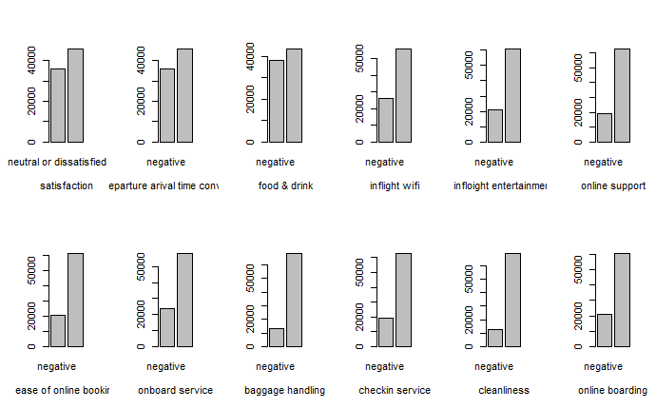
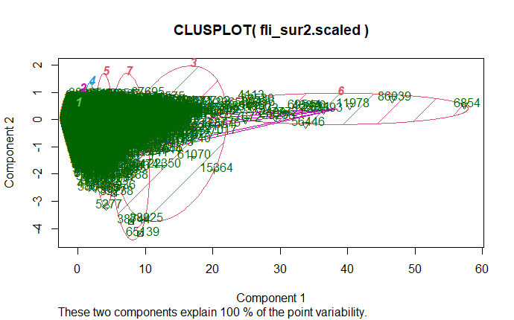
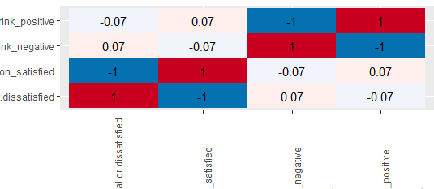
1. EDA & Treatment
3. Insights
Variable
Importanc$
1
2
3
Str & Read
Merge into 1
Missing Data
B$st KPIs
Colnames, str, summary
Merge by “ID”
== “ “ = “neutral”
A unit incr$ase will result in how much impact on the overall satisfaction
6
5
3
Transformation
Outliers
EDA
Positive - Negative
Kmean,clusplot, NBclust
Uni, BI, Correlations
4. $urika
Focus only on top 4 important variables to easily master and apply the enhancement suggested methods.
2. Intuition
Age
14 Variables Left
Like ID
1- CART
2- RF
3- L Regression
Remove UNIMPORTANT variables
Leg Room
LEAST Mon$yTim$$ffort
$=E
Flight Distance

Slide 4
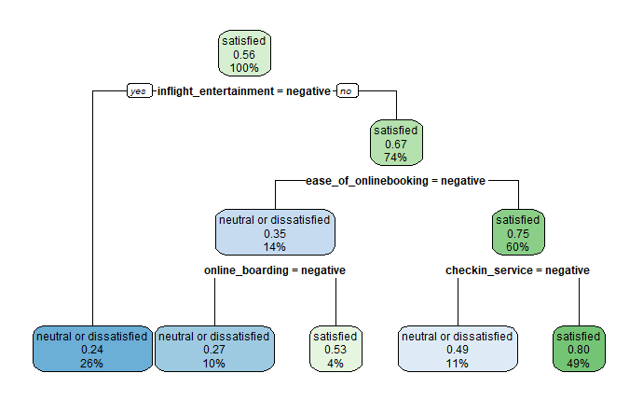
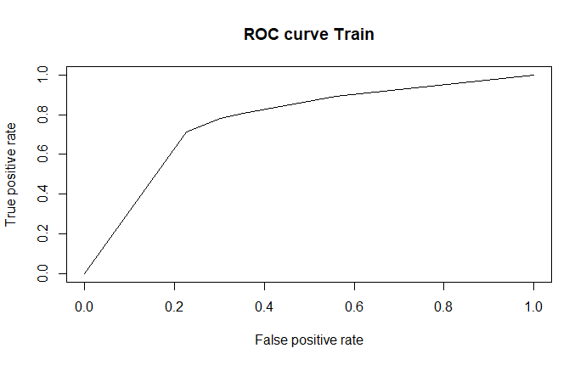
CART
KPI
Error Rate | 0.256
Accuracy | 0.743
Sensitivity | 0.715
Specificity | 0.765
AUC | 0.769
KS | 0.484
Gini | 0.281
Variable Importance:
1- Inflight $ntertainment | 2- $ase of Online Booking
3- Check in Service | 4- Onlin$ Boarding
LEAST Mon$yTim$$ffort
$=E

Slide 5
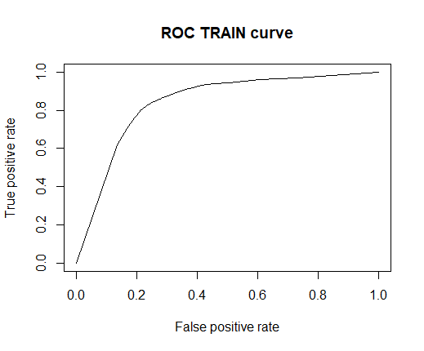
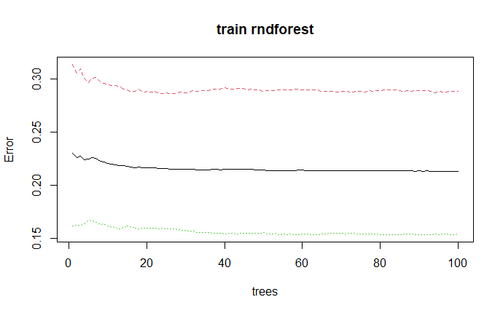
Random Forest
51
Tree
KPI
Error Rate | 0.201
Accuracy | 0.798
Sensitivity | 0.798
Specificity | 0.799
AUC | 0.840
KS | 0.590
Gini | 0.486
Variable Importance:
Lucky Number
1- Inflight $ntertainment | 2- food and drink
3- Check in Service | 4- Ease of online booking
LEAST Mon$yTim$$ffort
$=E

Slide 6
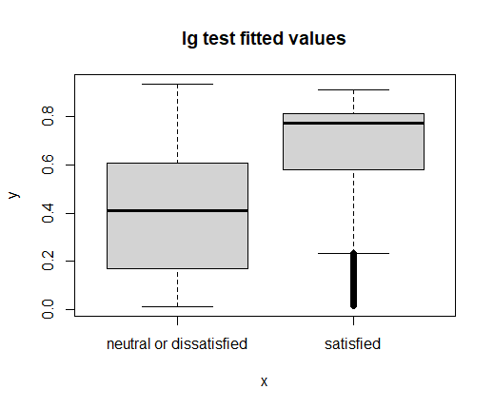
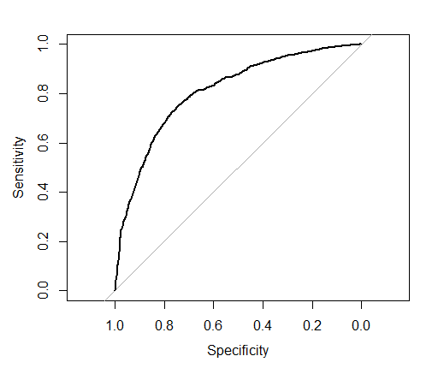
Logistic Regression
Variable | Impact
inflight_entertainmentpositive | 5.66
ease_of_onlinebookingpositive | 4.39
checkin_servicepositive | 2.64
online_boardingpositive | 1.70
KPI
Error Rate | 0.254
Accuracy | 0.745
Sensitivity | 0.698
Specificity | 0.787
AUC | 0.808
Interesting
Variable Importance:
1- Inflight $ntertainment (5.66) | 2- Ease of online booking (4.39)
3- Check in Service (2.64) | 4- Online Boarding (1.7)
LEAST Mon$yTim$$ffort
$=E

Slide 7
Model Comparisons
Best
Numbers
KPI/Model | CART Train | Forest Train | Logistic Regression Train
Error rate | 0.2563 | 0.2011081 | 0.2544623
Accuracy | 0.7437 | 0.7988919 | 0.7455377
Sensitivity | 0.7154 | 0.7984987 | 0.6989455
Specificity | 0.7652 | 0.7991585 | 0.7872234
AUC | 0.7692007 | 0.8408412 | 0.808
KS | 0.4842302 | 0.5907522
Gini | 0.2817875 | 0.486449
Logical
Results
Variable Importance:
 | CART | FOREST | Logistic Regression
1 | Inflight $ntertainment | Inflight $ntertainment | Inflight $ntertainment
2 | $ase of online booking | Food n Drink | $ase of online booking
3 | Check in service | Check in service | Onlin$ boarding
4 | Onlin$ boarding | $ase of online booking | Check in service
LEAST Mon$yTim$$ffort
$=E

Slide 8
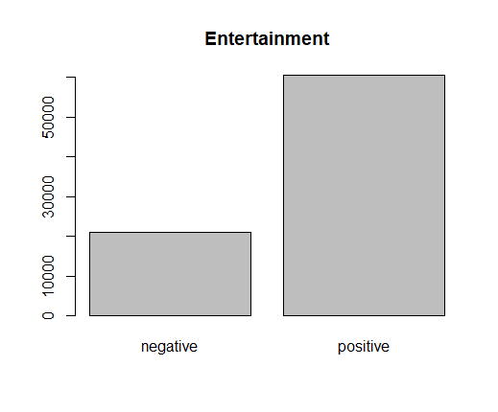
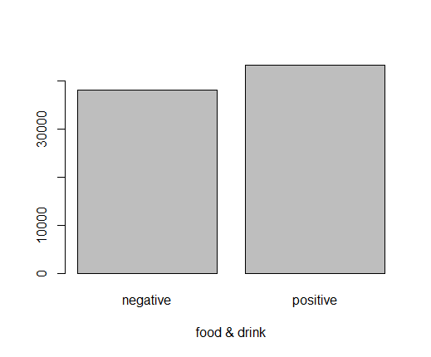
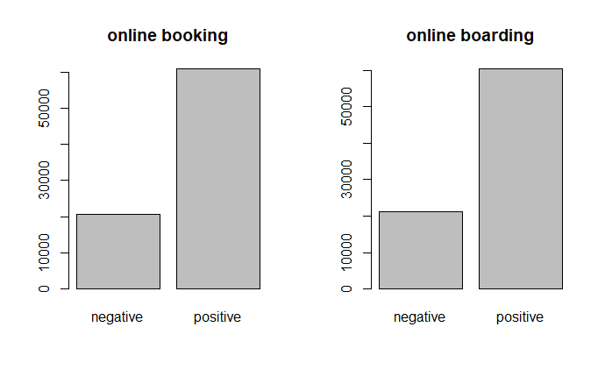
Model Interpretation
RF had the best numbers and logical answers but I will use from all models
Inflight $ntertainment is the most important variable
Food and Drink is the second most important variable
Ease of online booking and online boarding
Around 75% of passengers are satisfied from inflight entertainment
We need to increase 5 units to gain around 66%, which is not easy
Enhancing this variable will not cost a lot of money and effort
Around 55% of passengers are satisfied from inflight entertainment
Enhancing this variable will not cost a lot of money and effort
We can satisfy large percentage from the 45% that are dissatisfied
Around 75% of passengers are satisfied from their online booking and boarding
Increasing 1 units to gain 70% boarding
Enhancing those variables will not cost a lot of money and effort
These 2 variables must always be up to date and user friendly
LEAST Mon$yTim$$ffort
$=E

Slide 9
Recommendations:
They can start with Inflight $ntertainment because it will not cost a lot of money and effort, if we took into consideration that the hardware is upgradable and increasing it will affect the overall satisfaction - Inflight Wifi: this variable (rated 5 from the most important variables in RF), will increase satisfaction and will give passengers even more entertainment options using their personal devices.
Then Food and Drink, Even though it was only mentioned in RF model but i believe it should be second important from past experience. This variable can be upgraded with some little time and effort and adds up to around 50% of total passengers. (40k) have negative feedback, which means that we can satisfy a large percentage from those by making small and creative changes.
As for Online Booking and online boarding, even though 80% of passengers have positive feedback on them, but these variables must always be up to date and always should be easy and user friendly, so enhancing them will have positive feedback and as for the cost, it can be done with little money and effort
Overall customer satisfaction is good, “Falcon Airflight” is doing good and little effort can increase the overall satisfaction which will positively affect the reputation of “Falcon Airline” and the return on investment.
LEAST Mon$yTim$$ffort
$=E

Slide 10
Implementations(1/2):
LEAST Mon$yTim$$ffort
Inflight Entertainment:
I suggest focusing on targeting people ages between 7-30 (30% of total passengers) They follow trends and stay up to date with new releases and technologies (e.g. Adding new games, music and movies or adding network gaming between the passengers will add up to the overall passenger satisfaction.
Older passengers might care about news, documentaries and sports, which means; other channels of entertainment should be of reach.
Make 2 advertising campaigns to increase awareness of their inflight entertainment and target 1- new customers 2- retarget their frequent flyers to spread the word.
Make a new Application for the airlines where passengers can use from their devices to explore all available programs which will reduce the cost of the hardware.
Food and Drink:
Let customers Pre order from a served menu from different kitchens (middle easteren - mediteranean - american - asian - beef- chicken - fish- vegan etc)
Study the nationality of their customers, Get a food and beverage expert to suggest prefered dishes.
Prepare another survey for randomly chosen 10-20% passengers, ages 25 to 60, rated (poor & need improvement) and restudy the results using ML. Add variables like( nationality - ages - breakfast - snack - dinner - lunch - beverages - preferable cuisine) - compare between served food and new menu.
$=E

Slide 11
Implementations(2/2):
LEAST Mon$yTim$$ffort
Online Booking and Online Boarding:
Release an application to make online booking and boarding as easy and accessible as possibles.
I recommend they hire a reputable consulting online and user experience company and make some A/B testings to finally reach the best and more convenient online booking and boarding system.
Make another survey for the rest 20% whom they rated “negative” and again make another models to understand why they rated “negative”.
Type travel “business people”, results showed that there are around 8500 who rated the airlines “Need Improvement” - and 5300 “Poor”. To better understand these results they can prepare another survey specifically addressed to those people and investigate what needs to be done. This category of type travel which is usually executive men and women have better understanding in online services and can give us a better insight on how to improve our services to satisfy almost all segments.
$=E

Slide 12
The End

